Slide 1


Slide 2
LEARNING OUTCOMES
1.Students should know the various components of environment.
2.Students should understand the concepts of food chain, food web, trophic level, ecological pyramids, ozone layer ozone hole etc.
3.Students should able to identify the functions of different biotic components of an ecosystem.
4.Students should be able to appreciate the relationship between the different trophic levels of food chain and significance of maintaining it.
5.Students should develop love towards nature.
6.Students should be able to develop effective techniques to dispose garbage.
7.Students should realise their responsibility in protecting environment.
8. They should understand the significance of protecting ozone layer etc.

Slide 3
Every organism have to depend other objects for one or other purpose for it’s successful survival.
An organism is surrounded by many things on earth.
With these things an organism interact in it’s daily life.
Thus all those things surrounding an organism , to which it interact is called the environment

Slide 4
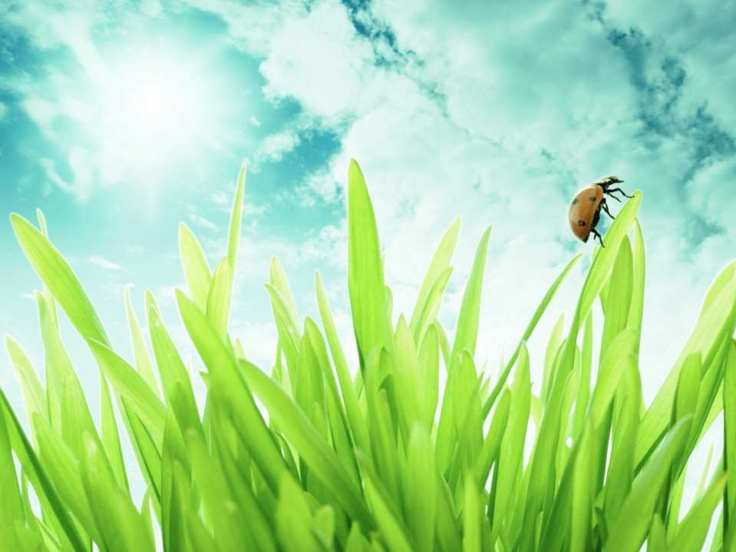
Effect of adding waste to the environment
Human activities produce a lot of waste materials which are thrown away into the environment. These wastes cause

Slide 5
pollution of air, water and soil. The waste materials produced are of two main types. They are biodegradable wastes and non biodegradable wastes.

Slide 6
i)Biodegradable wastes: are wastes which are decomposed into harmless substances by microorganisms. E. g. vegetables, fruits, pulses, cereals, cotton, jute, wool, wood, leather, paper, animal dung, animal bones

Slide 7
ii) Non biodegradable wastes :- are wastes which are not decomposed by microorganisms. E. g. polythene bags, plastics, synthetic fibres, glass, metals, synthetic rubber, insecticides, pesticides
etc.

Slide 8
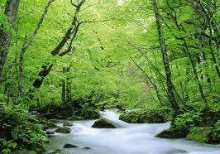
Sub-Concept 15.2 Eco-system – What are its components?

Slide 9
All organisms such as plants, animals, micro organisms and human beings as well as the physical surroundings interact with each other
All the interacting organisms in an area together with the non-living constituents of the environment form an ecosystem.
The components of an ecosystem can be placed under two groups, they are biotic (living) and abiotic ( non living) components.

Slide 10
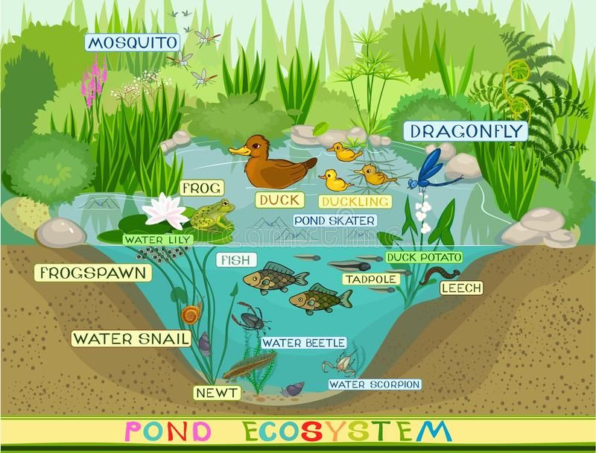

Slide 11
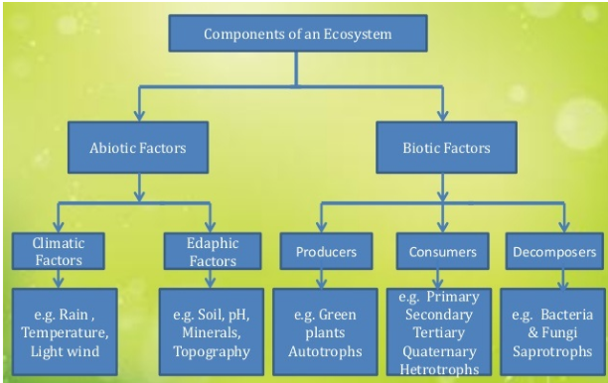
COMPONENTS OF ECOSYSTEM

Slide 12
Biotic components of the ecosystem can be sub divided in to different groups
1.Producers: these are the organisms that are able to prepare their food. Eg.all green plants and certain bacteria as they contain photosynthetic pigments.
2. Consumers : these are the organisms that consume food produced either directly from producers or indirectly by feeding on other consumers. Eg. Leaf insect, deer, Fox etc.

Slide 13
Consumers can be further classified as primary consumers (herbivores), secondary consumers (carnivores), omnivores and parasites.
Herbivores eat directly on plant materials , eg. Parrot, deer, cow etc.
Carnivores eat on other animals, eg. Fox, tiger etc.
Omnivores eat both plant and animal matter, eg. crow, Cat etc.
Parasites are those animals that live inside or outside the body of other organisms and get food from them eg. Tape worm, Round worm etc.

Slide 14
As a part of biotic components there are micro organisms in every ecosystem.
Microbes, bacteria and fungi break down the dead remains and waste products of organisms.
These micro organisms are the decomposers as they break down the complex organic substances into simple inorganic substances that go into the soil and used up by plants
This helps in the replenishment of soil nutrients.

Slide 15
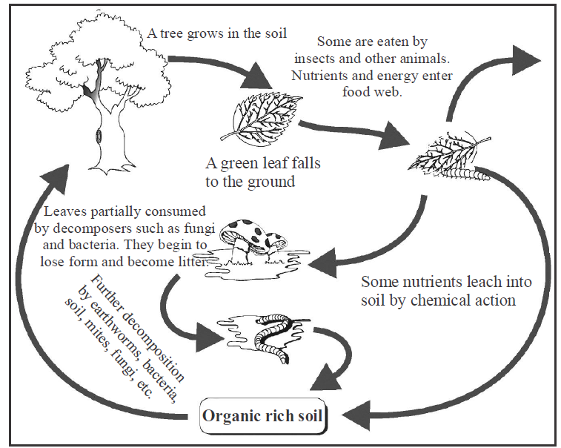
Action of decomposer

Slide 16
FOOD CHAINS AND FOOD WEBS
In an ecosystem we can see that one organism feed on another. Eg. Ina garden grass is eaten by grass hopper, frog eats grass hopper, snake eat frog like that.
Grass----> grass hopper---> frog-----> snake
This series of organisms feeding on one another form a food chain.
Each step or level of the food chain forms a trophic level

Slide 17
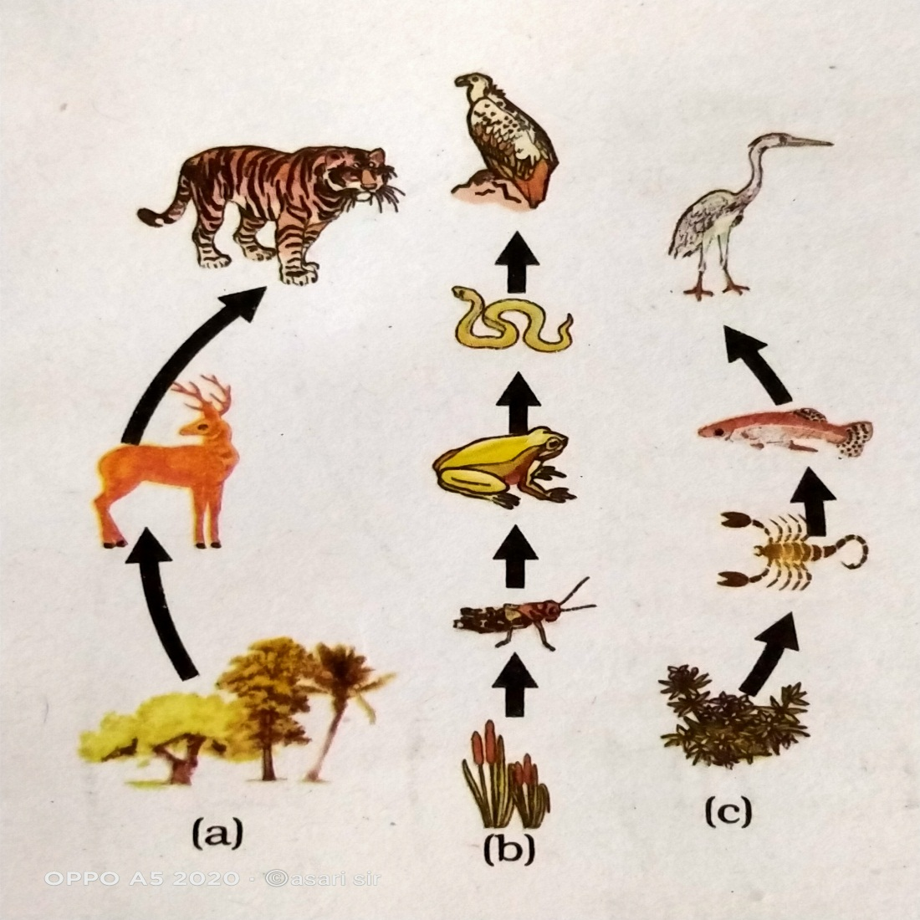
FOOD CHAIN

Slide 18
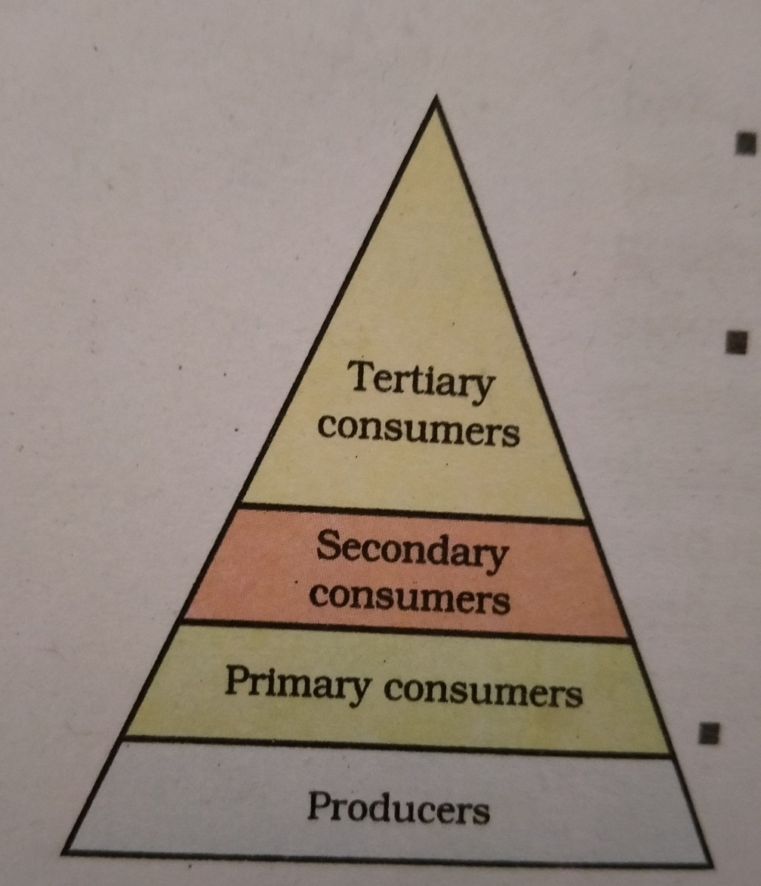
Autotrophs or the the producers are the first trophic level.
Herbivores or the primary consumers come at the second level.
Small carnivores or the secondary consumers at the third level.
Larger carnivores or the tertiary consumers form the fourth trophic level

Slide 19
ENERGY FLOW
The interactions among various components of the environment involves flow of energy from one component of the system to another
The autotrophs capture the energy present in sunlight and convert it in to chemical energy.
From autotrophs energy goes to the heterotrophs and decomposers. When one form of energy is changed to another , some energy is lost to the environment in the forms which cannot be used again.

Slide 20
The flow of energy between various components of the environment follow the following conditions
The green plants capture about 1% of the energy of sunlight that falls on their leaves and convert it in to chemical energy.
When green plants are eaten by primary consumers, a lot of energy is lost as heat to the environment some amount goes in to doing work and rest goes towards growth and reproduction. An average 10%of the food eaten is turned in to it’s own body and made available for the next level of consumers.

Slide 21
Therefore , 10% can be taken as the average value for the amount of organic matter that is present at each step and reaches the next level of consumers.
Since little energy is available for the next level of consumers, food chain generally consists of only three or four steps.
There are generally greater number of individuals at at the lower trophic levels of an ecosystem.
The length and complexity of food chains vary greatly. Each organism is generally eaten by several other organisms. So instead of straight line food chain , the relationship can be shown as a series of branching lines called a food web.

Slide 22
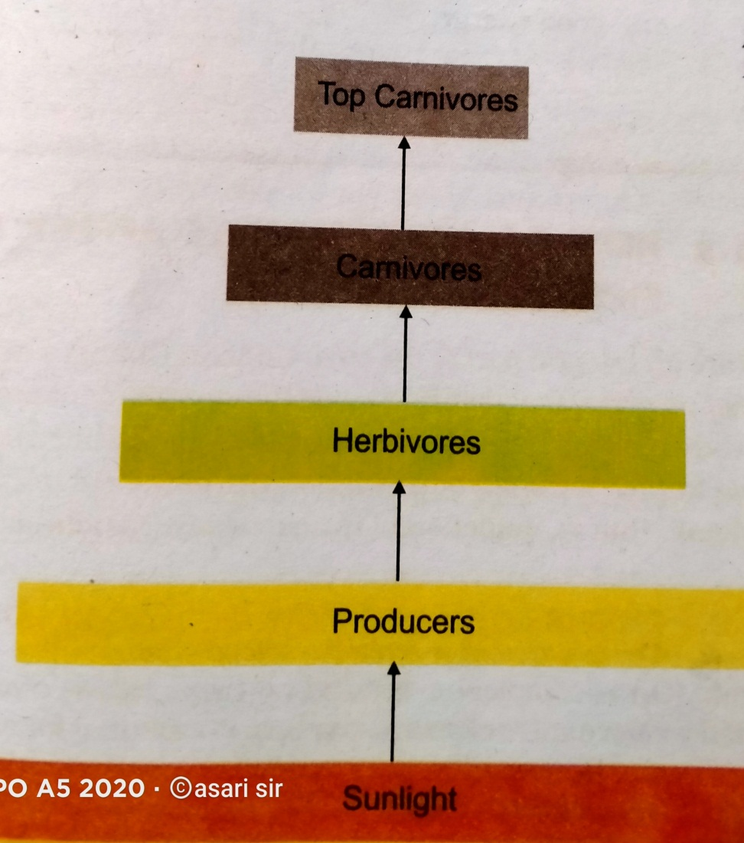
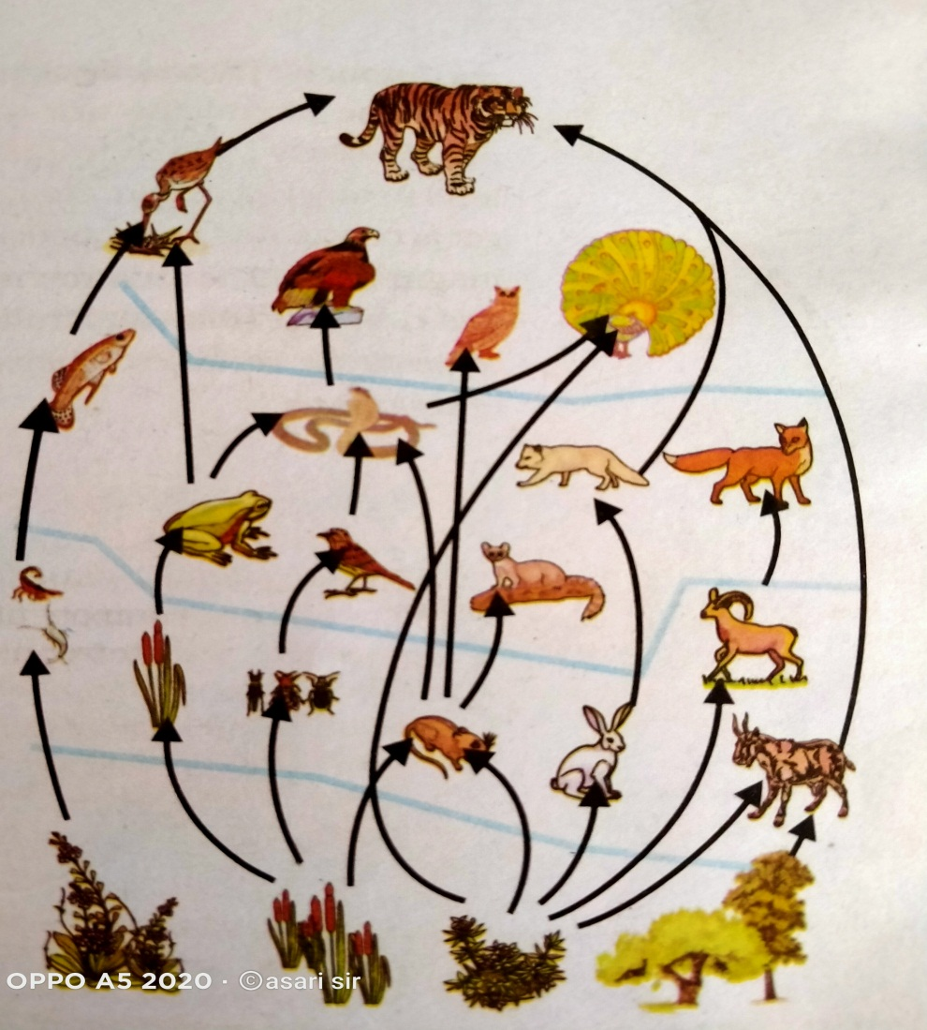
FLOW OF ENERGY
FOOD WEB

Slide 23
From the energy flow diagram two things become clear.
1.The flow of energy is unidirectional
2.The energy available at each trophic level gets diminished progressively

Slide 24
BIOLOGICAL MAGNIFICATION
Harmful chemicals in our body through the food chain.
We use several pesticides and other chemicals to protect our crops from diseases and pests.
These chemicals are washed down into the the soil or in to the water bodies.
From the soil it is absorbed by plants along with water and minerals.
From the water these are taken up by aquatic plants and animals.
As these chemicals are non- biodegradable , these get accumulated progressively at each trophic level.

Slide 25
The maximum concentration of these chemicals get accumulated in our bodies.
This progressive accumulation of harmful chemicals in the body of organisms through food chain is called biological magnificatio.

Slide 26
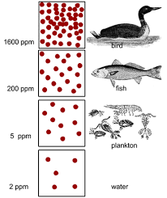
BIOLOGICAL MAGNIFICATION IN A POND

Slide 27
OZONE LAYER AND IT’S DEPLETION
Ozone is a protective layer of the atmosphere.
It is located in the lower portion of the stratosphere from approximately 15-35 km. above earth.
Ozone (O3) is a molecule formed by 3 atoms of oxygen. Ozone is a deadly poison, how ever at the higher levels of the atmosphere, ozone performs an essential function.
It shields the surface of the earth from ultraviolet radiations from the sun.

Slide 28
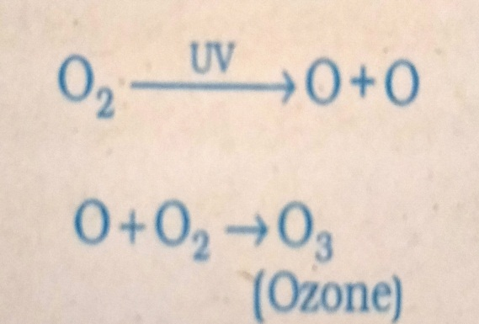
UV radiation is highly damaging to organisms.
It is known to cause skin cancer, mutations, damage to eye etc.
Ozone is formed by the action of UV radiation on oxygen. The UV radiation split apart some molecular O2 into free oxygen (O)atoms.
These atoms then combine with molecular oxygen to form ozone.

Slide 29
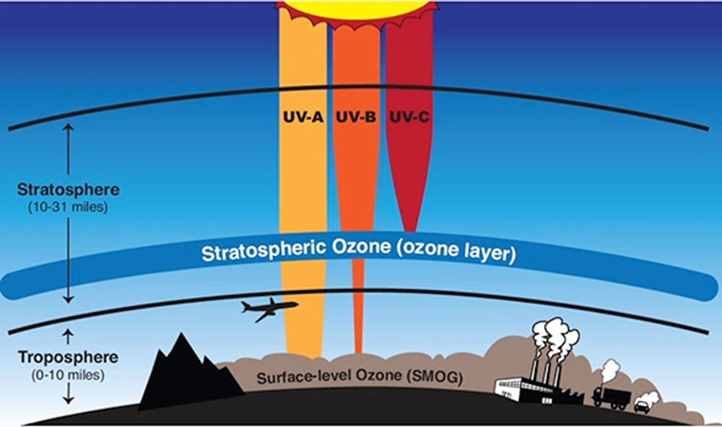
OZONE LAYER

Slide 30
MANAGING GARBAGE
In our daily life we use to throw away many solid materials which are not useful to us.
All these left out solid waste constitute garbage.
In our experience many of these waste materials disappear after some time, where as others will remain in our surrounding with out any change indefinitely.

Slide 31
These materials may become harmful to the various members of the ecosystem.
They may cause mechanical injury to us, reduce the soil quality, prevent percolation of water in to the soil, health problems to cattle and other wild animals.

Slide 32
Many methods can be suggested to dispose garbage.
These include Recycling, reuse, repurposing, Refuse, incineration, segregation etc.
Improvement in our life style have resulted in greater amount of waste material generation. Change in our attitude also have a role to play, with more and more things we use becoming disposable.
Changes in packaging have resulted in much of our waste becoming non biodegradable.

Slide 33
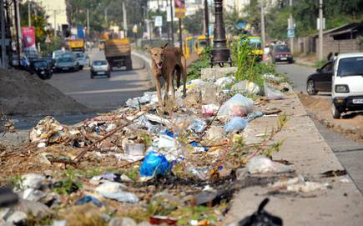
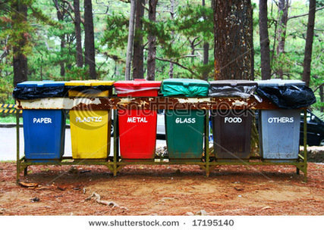
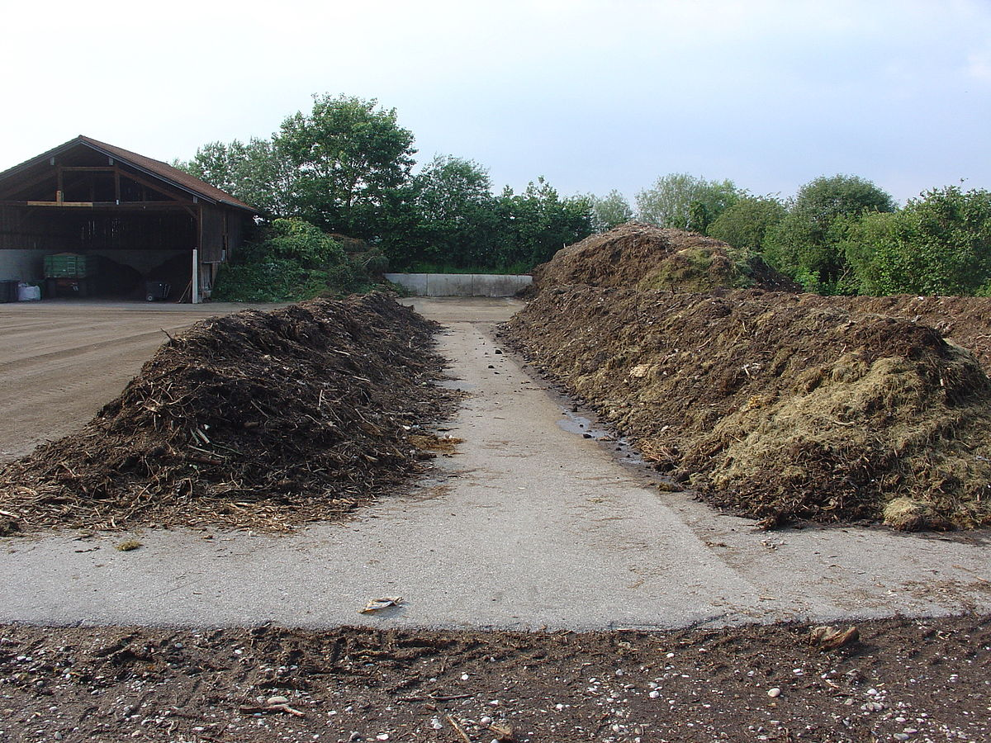

Slide 34
THANK YOU

